Slide 1
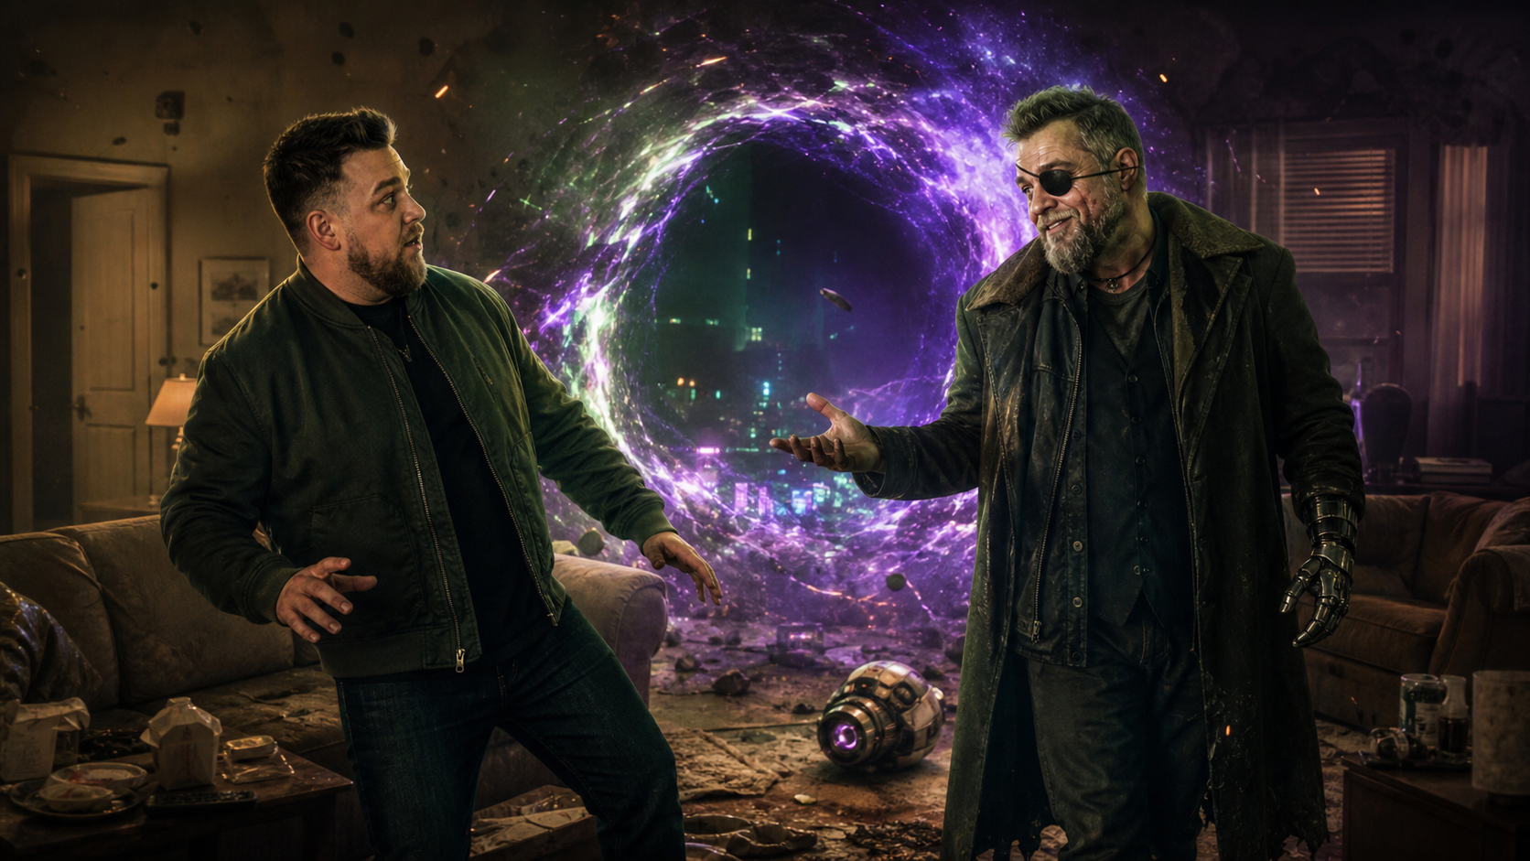
ME, FUTURE
ROOMMATE
SCI-FI COMEDY FEATURE
THE WORST PERSON HE KNOWS IS HIMSELF.
WRITTEN BY DAN GALEA
ENTER
Notes:
Open on the contradiction: epic time travel, catastrophic roommate energy.
[Sources]
- User-provided synopsis and title.
- OpenAI ImageGen key art, generated 2026-08-24 from user-provided Dan.PNG identity reference.

Slide 2
ENTER THE TIMELINE
A CLICKABLE ROUTE THROUGH THE PITCH
01
THE HOOK
The premise in one impossible knock.
→
02
THE MOVIE
The scam, the chase, the double act.
→
03
THE WORLD
Polizza. Cilantro cars. Time bureaucracy.
→
04
THE HEART
Would you like the person you become?
→
05
THE CREATOR
Dan Galea and the comic point of view.
→
CLICK ANY CHAPTER — OR JUST KEEP GOING.
Notes:
This is the interactive hub. Each chapter row jumps to its section; every later slide has persistent navigation.
[Sources]
- User-provided story materials.

Slide 3
MFR
HOOK
MOVIE
WORLD
HEART
TEAM
THE HOOK
“
A STRUGGLING GUY’S BATTERED FUTURE SELF SHOWS UP LOOKING FOR A PLACE TO LIVE.
He thinks he’s been handed the ultimate guide to avoiding every mistake.
Instead, he discovers Future Dan is a time-travelling con artist — and the Time Cops need Dan to hunt down the worst person he knows:
HIMSELF.
03
Notes:
Deliver the premise cleanly, then land on the identity punchline.
[Sources]
- User-provided logline, condensed for slide copy.

Slide 4
MFR
HOOK
MOVIE
WORLD
HEART
TEAM
THE MOVIE
ONE KNOCK. TWO DANS. ZERO BOUNDARIES.
01
02
03
04
KNOCK
BARGE
REVEAL
DEAL
→
→
→
Dan ignores the door until the knocking becomes impossible to ignore.
A scarred, eye-patched stranger walks in and claims the couch.
“I’m you in the future.” He needs meat. And somewhere to sleep.
Dan lets him stay — because kicking yourself out feels rude.
The first act weaponizes the most ordinary room in the world: a shared apartment.
04
Notes:
The opening sells the engine before the larger mythology arrives.
[Sources]
- User-provided synopsis.
- MFR.pdf early screenplay excerpt, opening pages 1-3.

Slide 5
MFR
HOOK
MOVIE
WORLD
HEART
TEAM
THE DOUBLE ACT
CHOOSE YOUR DAN
Same face. Opposite relationship with consequences.
PRESENT
FUTURE
DAN
DAN
Still believes information can save him from becoming himself.
Already learned the wrong lesson from every mistake he ever made.
MEET HIM →
MEET HIM →
05
Notes:
This slide branches to either character profile; continue linearly for both.
[Sources]
- User-provided character premise.

Slide 6
MFR
HOOK
MOVIE
WORLD
HEART
TEAM
PRESENT DAN
THE GUY WHO THINKS FUTURE KNOWLEDGE COUNTS AS PERSONAL GROWTH.
“
I DON’T WANT TO BECOME YOU.
WANTS
A shortcut to a better life.
NEEDS
To take responsibility before consequences arrive.
Unfortunately, that may require doing something.
COMIC WEAPON
Confidence wildly outpacing competence.
MEET FUTURE DAN →
06
Notes:
Present Dan is the audience surrogate: tempted by the hack, forced into the work.
[Sources]
- User-provided synopsis and heart statement.

Slide 7
MFR
HOOK
MOVIE
WORLD
HEART
TEAM
FUTURE DAN
A MENTOR, A WARNING — AND A COMPLETE FRAUD.
Broke. Battered. Rat-displaced. Still somehow smug.
01
THE PITCH
He knows the dates, decisions and investments that destroy Dan’s life.
02
THE TRICK
When Present Dan changes a choice, Future Dan physically changes with it.
03
THE SCAM
He steals valuables, eats the food, pockets the phone and jumps timelines.
THE WORST PART? HE KNOWS EXACTLY WHAT DAN WILL FALL FOR.
07
Notes:
Future Dan drives the plot because his con is psychologically bespoke.
[Sources]
- User-provided synopsis.
- MFR.pdf early screenplay excerpt, scam reveal and stolen phone beats, pages 11-14.

Slide 8
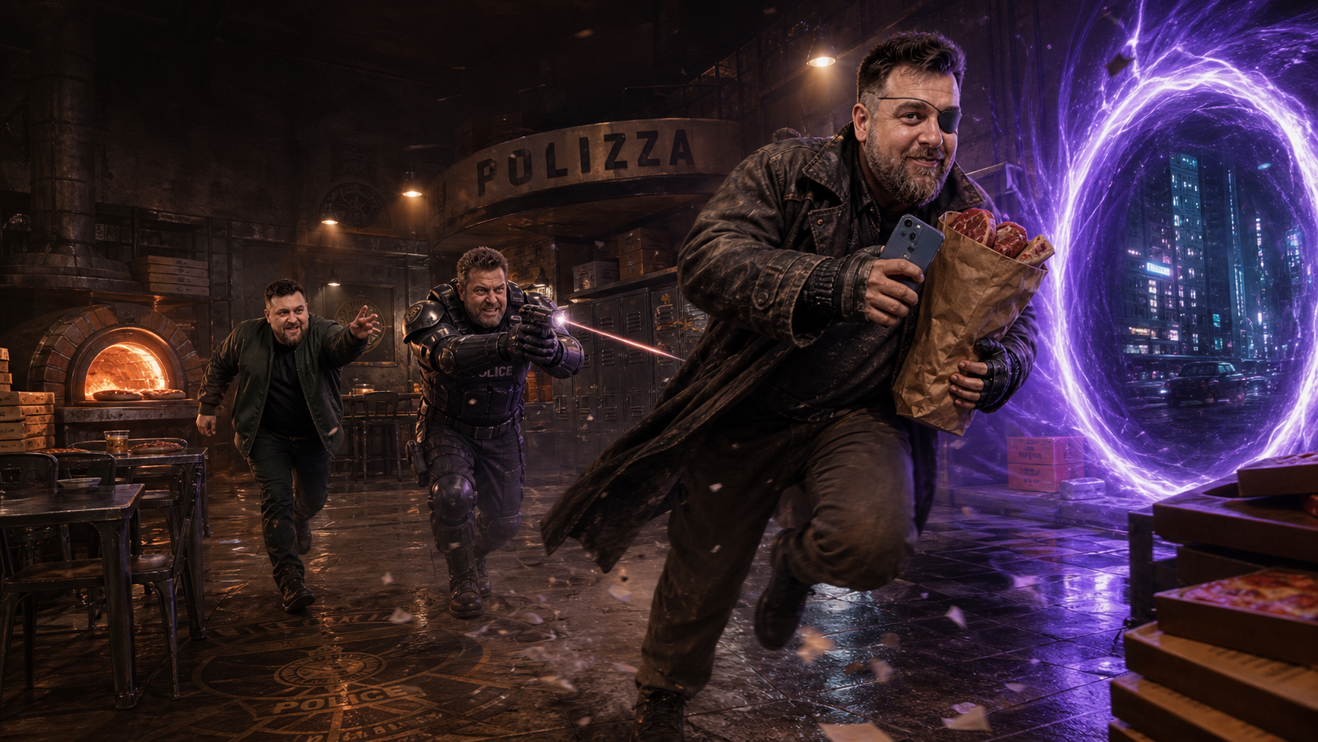
MFR
HOOK
MOVIE
WORLD
HEART
TEAM
THE TIME COPS
AGENT
KNARVELL
Burned out. Underfunded.
Completely done with Dan.
THE MISSION
Recruit the one variation who can anticipate Future Dan’s next stupid decision.
WHO BETTER TO PREDICT DAN—THAN DAN?
08
Notes:
Knarvell is the exhausted straight man who gives the comedy stakes, rules and propulsion.
[Sources]
- User-provided synopsis.
- OpenAI ImageGen chase visual, generated 2026-08-24 from user-provided Dan.PNG identity reference.

Slide 9
MFR
HOOK
MOVIE
WORLD
HEART
TEAM
THE STORY ENGINE
EVERY “FIX” CREATES A NEW PROBLEM.
1
2
3
FUTURE DAN
NAMES A MISTAKE
PRESENT DAN
CHANGES COURSE
FUTURE DAN
CHANGES TOO
→
→
A disastrous date. A terrible choice. A suspicious stock tip.
The timeline edits itself in real time.
Scars vanish. Eyes return. Lies multiply.
Then the portal opens — and the self-improvement comedy becomes a manhunt.
09
Notes:
This loop sustains the first-act comedy and makes the later pursuit personal.
[Sources]
- User-provided synopsis.
- MFR.pdf early screenplay excerpt, scar/eyesight/dead-hand sequence, pages 4-10.

Slide 10
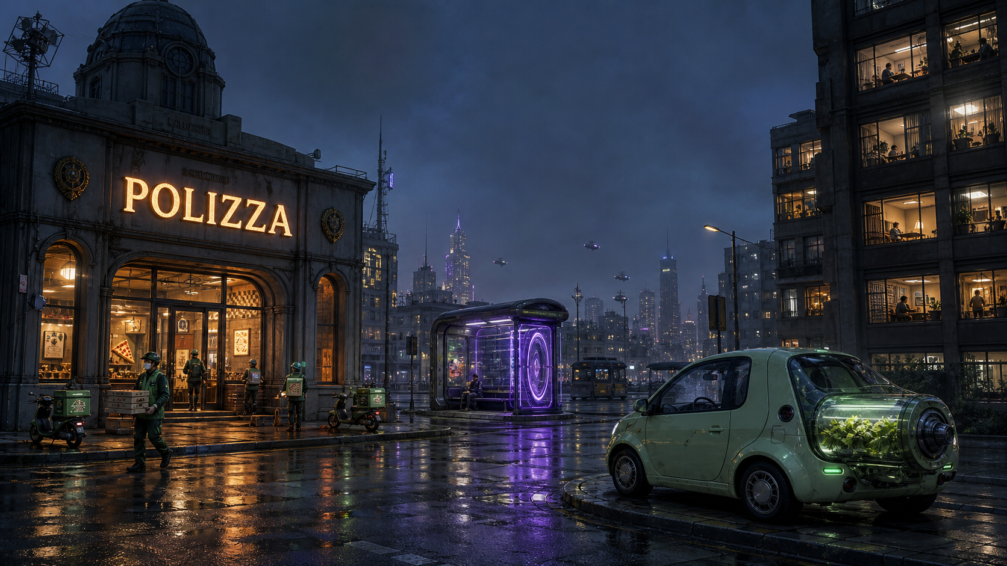
MFR
HOOK
MOVIE
WORLD
HEART
TEAM
THE FUTURE WORKS. HUMANITY DOESN’T.
Impossible technology. Embarrassingly ordinary applications.
POLIZZA
CILANTRO CARS
PORTAL COMMUTE
Police precincts, now serving slices.
The future of fuel smells aggressively fresh.
Time travel, treated like public transit.
10
Notes:
The world is funny because nobody treats the impossible as special.
[Sources]
- User-provided comedy and world-building section.
- MFR.pdf early screenplay excerpt, cilantro Ford and Polizza/remote-work police beats, pages 9-16.
- OpenAI ImageGen world visual, generated 2026-08-24.

Slide 11
MFR
HOOK
MOVIE
WORLD
HEART
TEAM
THE COMEDY
THE BIGGEST IDEA IN PHYSICS.
WASTED ON THE DUMBEST PROBLEMS.
DAGGER DATE
DEAD HAND
Avoiding one allergic dinner erases Future Dan’s scar.
He stopped moving it so people would stop asking for help.
LIFE-SUIT RANDOM
MEAT HEIST
Advanced disguise tech turns Knarvell into an old lady.
A time criminal crosses decades for groceries and a phone.
MFR treats causality like a setup — and the timeline like a punchline.
11
Notes:
These set pieces show the repeatable comic language: specific, visual and character-rooted.
[Sources]
- User-provided comedy section.
- MFR.pdf early screenplay excerpt, pages 4-17.

Slide 12
MFR
HOOK
MOVIE
WORLD
HEART
TEAM
TONE
UNAPOLOGETICALLY STUPID
IN THE SMARTEST POSSIBLE WAY.
BACK TO
THE FUTURE
HOT TUB
TIME MACHINE
BILL & TED
EVERYTHING
EVERYWHERE
High-concept propulsion
Shameless buddy chaos
Sweet idiot logic
Emotional multiverse scale
FAST / ABSURD / CHARACTER-DRIVEN / CINEMATIC
12
Notes:
The comparison titles are tonal coordinates, not a promise to imitate their plots or visual identity.
[Sources]
- User-provided tone and comparison titles.

Slide 13
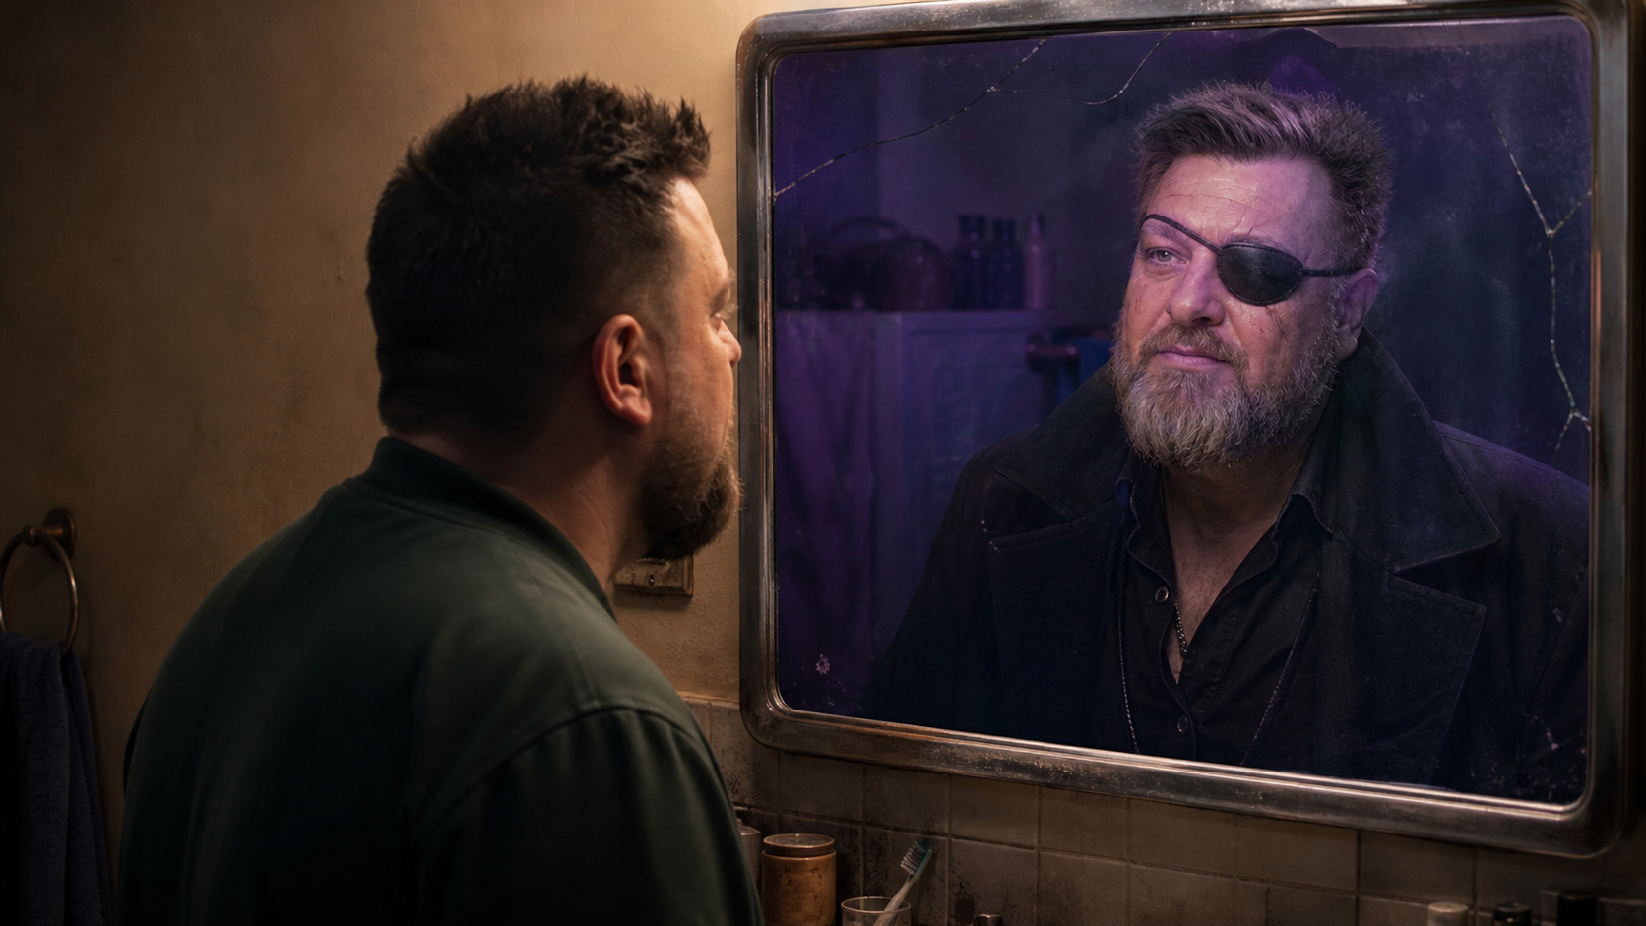
MFR
HOOK
MOVIE
WORLD
HEART
TEAM
THE HEART
IF YOU MET THE PERSON YOU WERE DESTINED TO BECOME…
WOULD YOU LIKE HIM?
To stop Future Dan, Present Dan has to do more than save the timeline.
He has to prove he can become somebody different.
13
Notes:
The spectacle externalizes a familiar fear: that every small avoidance is building someone we may not respect.
[Sources]
- User-provided heart section.
- OpenAI ImageGen mirror visual, generated 2026-08-24 from user-provided Dan.PNG identity reference.

Slide 14
MFR
HOOK
MOVIE
WORLD
HEART
TEAM
WHY THIS MOVIE
A COMMERCIAL ENGINE WITH A HUMAN FACE.
01
ONE STAR. TWO GREAT ROLES.
A dual performance with instant trailer language and comic contrast.
02
CONTAINED CORE. EXPANSIVE WORLD.
The apartment launches a time-spanning chase without losing intimacy.
03
VFX WITH A PUNCHLINE.
Every portal, life-suit and future gadget exists to reveal character.
04
A REPEATABLE UNIVERSE.
Time Cops, self-scams and alternate Dans create room beyond one mission.
HIGH-CONCEPT HOOK + CHARACTER COMEDY + AN EMOTIONAL QUESTION THAT TRAVELS
14
Notes:
These are creative-positioning advantages, not financial forecasts.
[Sources]
- Inferences from the user-provided premise and requested feature format; no external market claims.

Slide 15

MFR
HOOK
MOVIE
WORLD
HEART
TEAM
THE CREATOR
DAN
GALEA
WRITER
A comic point of view built on specific absurdity: big genre machinery, petty human behaviour, and one protagonist forced to share a room with his own worst instincts.
ME, FUTURE ROOMMATE
15
Notes:
Keep the creator slide focused on the voice evident in the material; no unsupported biography has been invented.
[Sources]
- User-provided Dan.PNG portrait.
- User-provided synopsis and MFR.pdf writing sample.

Slide 16
MFR
HOOK
MOVIE
WORLD
HEART
TEAM
THE WORST ROOMMATE
IS ALREADY INSIDE THE HOUSE.
ME, FUTURE ROOMMATE
SCI-FI COMEDY FEATURE / WRITTEN BY DAN GALEA
RESTART THE TIMELINE ↻
16
Notes:
Close on the cleanest expression of the movie’s comic and emotional promise.
[Sources]
- User-provided title, author credit and premise.

